Slide 1




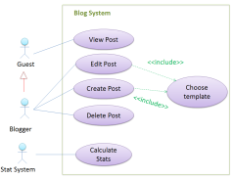
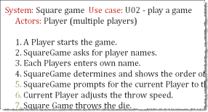
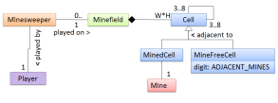
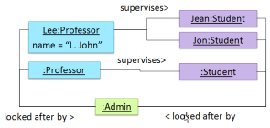
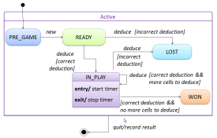
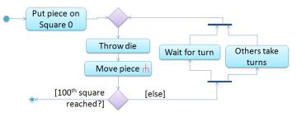
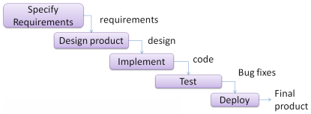
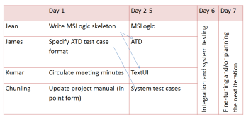
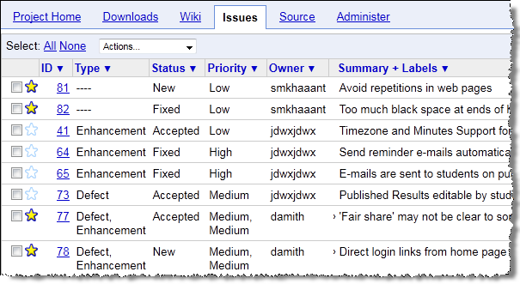
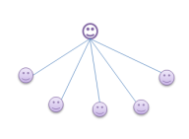

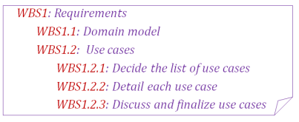
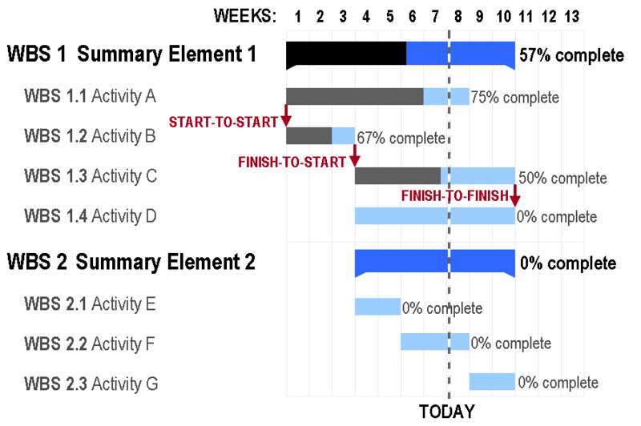
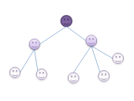

ANALYSIS
We use OO to ‘align the view’.
We use UML as the standard notation.
DESIGN
IMPLEMENTATION
QUALITY ASSURANCE
(Complex) Problem domain
Stakeholders
RCS
= Validation & Verification
Establish requirements…
brainstorming
Focus groups
User surveys
Product surveys
Observations
Interviews
Prototyping
System Specification
A
B
D
C
Architecture
Unit testing
A
C
A
B
Can be top-down, bottom-up, sandwich, big-bang
Can use styles such as n-tier, client-server, peer-to-peer, broker, pipes-and-filters, service-oriented, transaction-processing, and MVC
D
D
Combat complexity…
Use abstraction, build models
B
Sequence diagrams
Integration
Developer testing
Other V&V techniques:
formal verification
static analyzers
code reviews
…
Can be late-one-time, or early-and-continuous
Specify requirements…
Textual descriptions
Feature list
User stories
Use cases
OO domain models
Object diagrams
State machine diagrams
Activity diagrams
UI prototypes
Glossary
Supplementary requirements
…
Top-down design
Integration testing
API (Application Programming interface)
Testing
B
After modifications… Regression testing
QA
x
y
Class diagrams
y
Framework
System testing
Detailed design
Detailed design
z
Bottom-up design
System
Test cases
x
z
Library
operations
More agile -> less upfront detailed design
Platform
Made up as you go → Exploratory testing
Predetermined → Scripted testing
Can be created in these ways:
Black-box, Glass-box, Grey-box
User
Acceptance testing
Alpha/beta testing
Detailed design
Detailed design
Detailed design
Possible Improvements:
Refactor code
Coding standards and good coding practices
Protect code using assertions, exceptions, logging, and defensive coding.
Build automation
Continuous Integration
Possible Improvements:
Automate testing
Use Test-Driven Development
Increase efficiency and effectiveness of testing (Equivalence partitioning, Boundary Value analysis)
Increase test coverage (function/entry/exit/statement/branch/ condition/path coverage)
isolate SUT using drivers, stubs and dependency injection
Possible Improvements:
↑Cohesion, ↓Coupling
Apply design patterns (Abstraction Occurrence, Singleton, Command, Observer)
Apply design principles (Open/close, Law of Demeter, Separation of concerns, …)
Use polymorphism (inheritance, interfaces, dynamic binding)
Good product design guidelines (e.g., usability, …)
Possible Improvements:
Apply OO principles e.g. SOLID
Apply analysis patterns
Categorize and prioritize requirements
Requirements Specification
Sequential
Unified process
Project plans
Team structures
CMMI
Work-breakdown structures
PROJECT MANAGEMENT
Agile processes
Chief-programmer
Iterative
Issue trackers
Includes buffers and milestones
Egoless
Breadth-first
Depth-first
XP
Scrum
Strict hierarchy

